Slide 1
Details and reporting

Slide 2
Centering variables
Checking assumptions
Choosing random effect structures
Testing random effects
Testing fixed effects
Post-hoc tests and contrasts
Convergence problems

Slide 3
Centering is important
Centering variables just means subtracting the mean
Can also divide by 2 standard deviations (i.e. scaling)
Aids comparison between variables
Gelman 2008 http://www.stat.columbia.edu/~gelman/research/published/standardizing7.pdf
Why?
Intercepts (like all coefficients) are CONDITIONAL on the others
Intercept is the sample mean, conditional on all other predictors = 0
Notes:
http://www.stat.columbia.edu/~gelman/research/published/standardizing7.pdf
More explanation here: https://www.theanalysisfactor.com/center-on-the-mean/

Slide 4
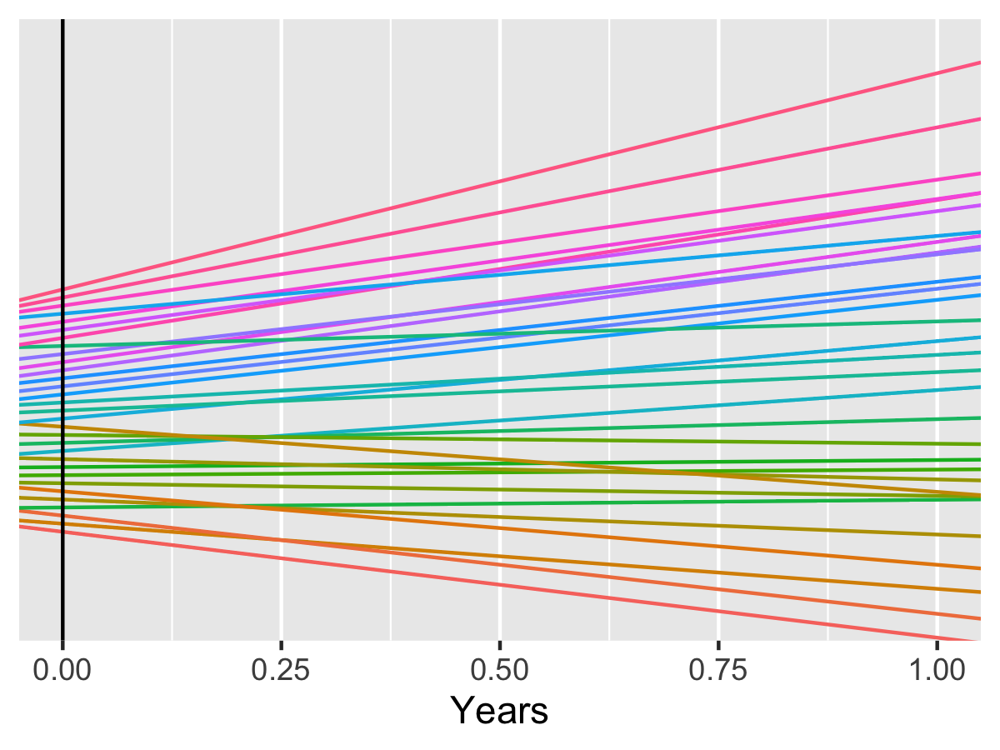
Why does it matter? Zero-based predictor
Notes:
Our random intercepts and VPC would be estimated where the black vertical line is.

Slide 5
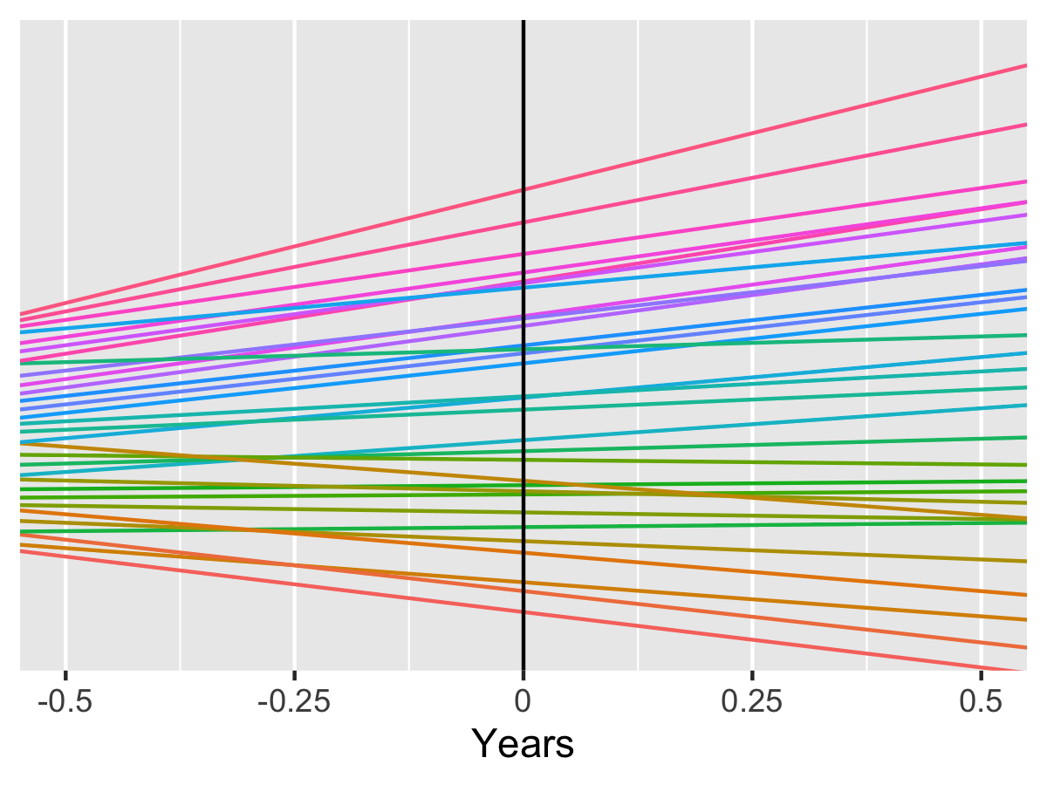
Mean centred predictor (subtract mean from all predictor values)
Notes:
Now we have mean centered.
Our random intercepts and VPC would still be estimated where the black vertical line is.
This means

Slide 6
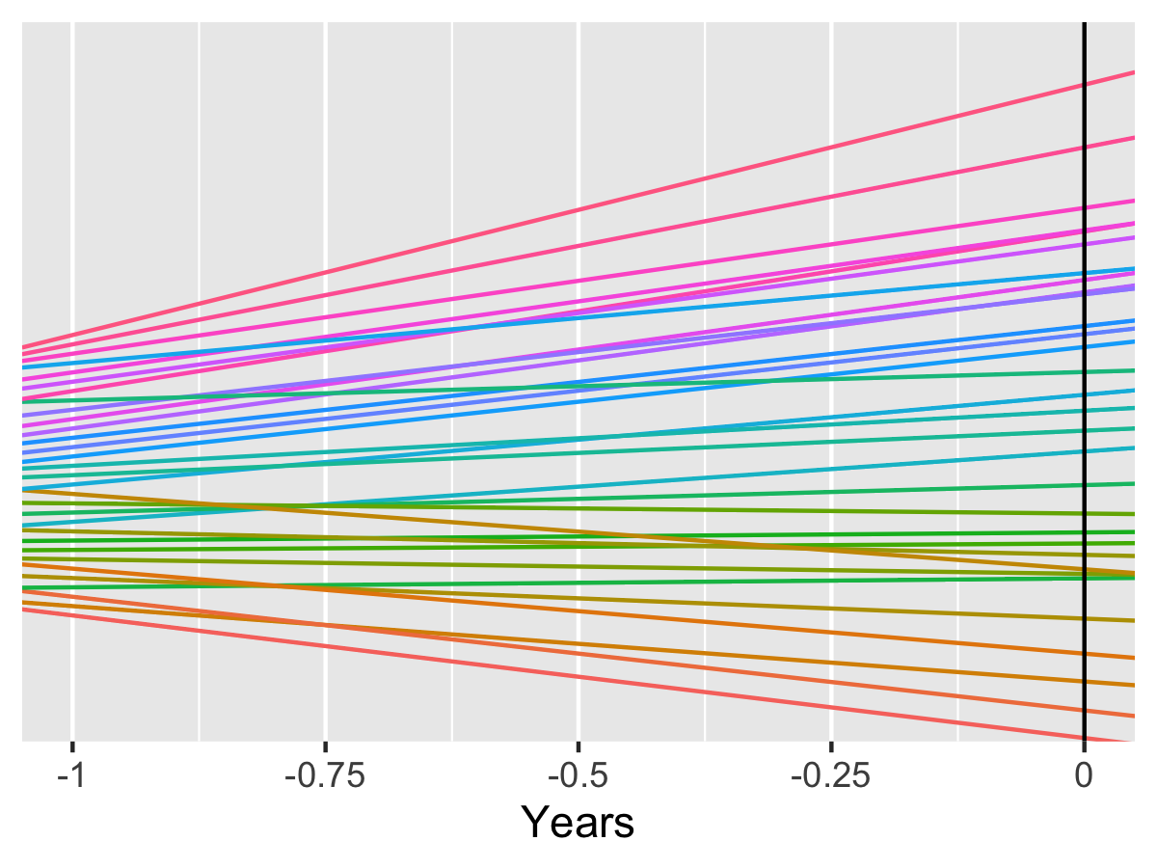
Zero at endpoint (subtract max from all predictor values)
Notes:
Now we have mean centered.
Our random intercepts and VPC would still be estimated where the black vertical line is.
This means

Slide 7
Pigs dataset – transform `week` variable
m1 <- lmer(weight ~ week + (week|id), data=pigs)
m2 <- lmer(weight ~ week + (week|id),
data=pigs %>% mutate(week=week - mean(week)))
m3 <- lmer(weight ~ week + (week|id),
data=pigs %>% mutate(week=week - max(week)))

Slide 8
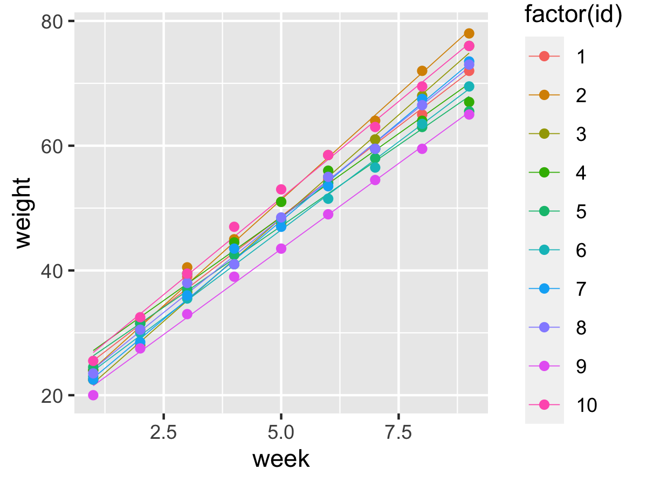
Pigs dataset – transform `week` variable
M1) Zero (default)
81% between variance
M2) Mean centred
90% between variance
M3) End-based
95% between variance

Slide 9
Recommendations
(Almost) always mean-centre continuous variables
Only leave as zero-based if you want to compare within/between variance at zero (i.e. it's meaningful)
For more explanation/discussion see Bosker and Snijders book
Notes:
Older edition of B&S ebook free here https://www.researchgate.net/publication/44827177_Multilevel_Analysis_An_Introduction_to_Basic_and_Advanced_Multilevel_Modeling

Slide 10
Assumptions
Normality of residuals
Homogeneity of Variance/Homoscedasticity
Others (but those are most important)

Slide 11
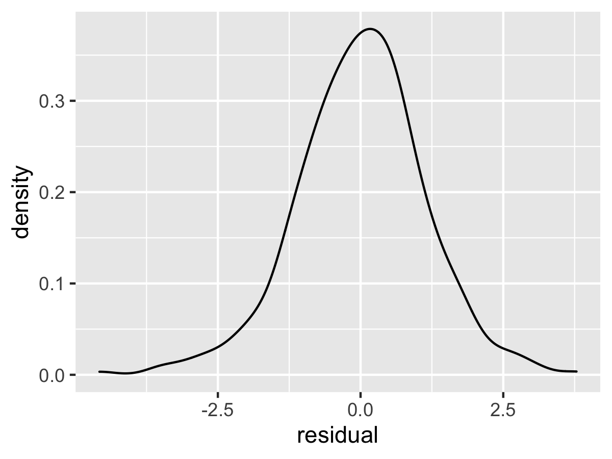
Normality of residuals
Notes:
This is a density plot of the residuals from the model
These look mostly fine.

Slide 12
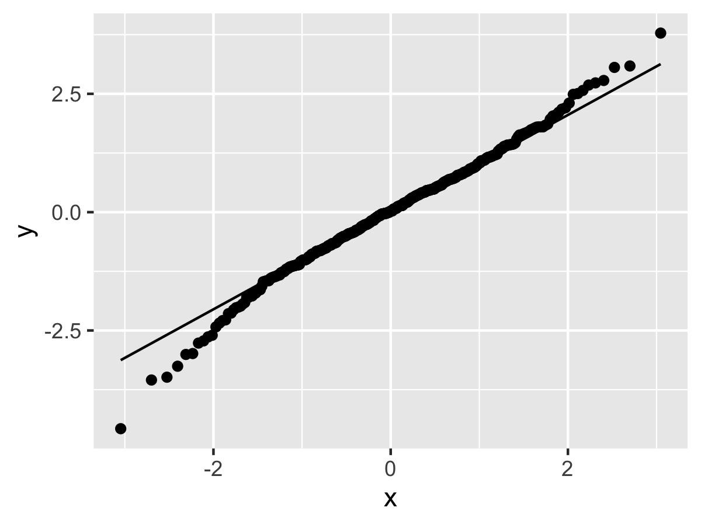
Normality of residuals
Notes:
A qq plot is another way of showing the same thing

Slide 13
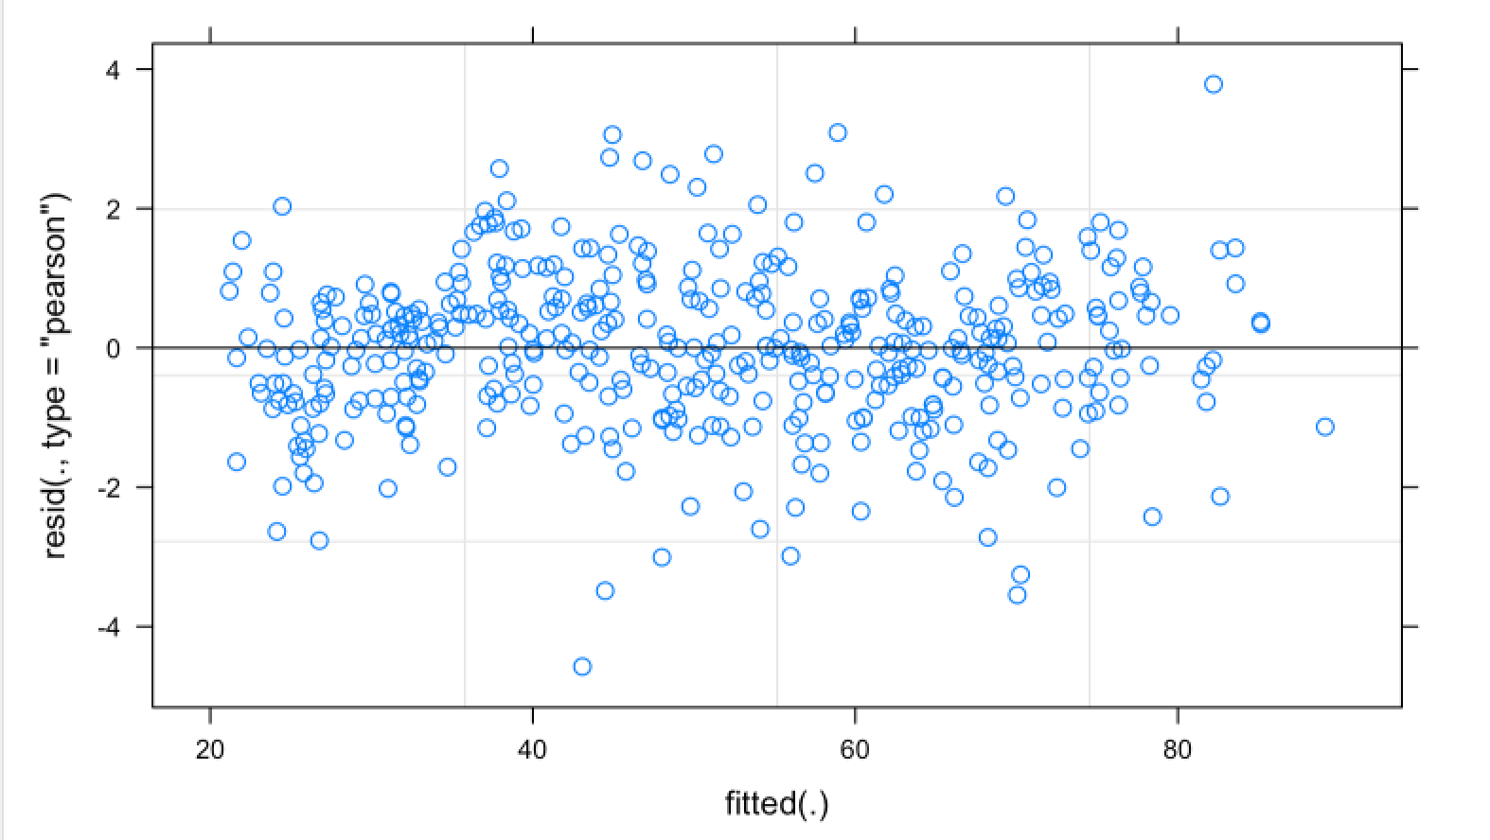
Homogeneity of variance
Notes:
If you use the plot function on an lmer model you get this plot
It shows residuals (y axis) against the fitted (predicted) value.
We want to see an even spread on both sides of zero, all the way along the x axis.
This example looks fine.

Slide 14
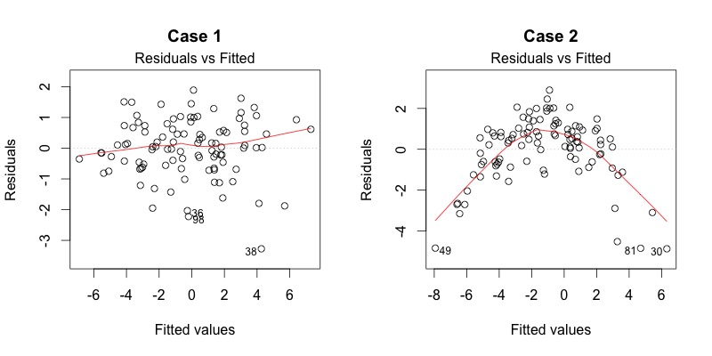
Good/bad examples
Notes:
https://data.library.virginia.edu/diagnostic-plots/

Slide 15
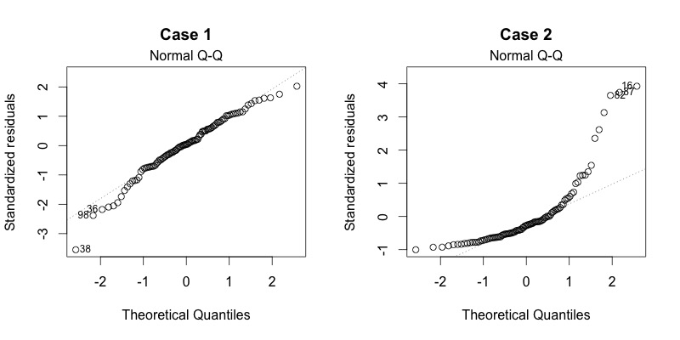
Good/bad examples

Slide 16
Selecting random effects
Keep it maximal? (Barr)
Start with all random effects
If you can't get it to fit, remove some of them(!)
Then add fixed effects (Sequential approach)
Share RMarkdown with all steps (Meteyard 2018)

Slide 17
Example
# maximal random effects
lmer(weight ~ 1 + (week|id), data=pigs)
# drop covariance for intercept and slope
lmer(weight ~ 1 + (1|id) + (0 + week | id), data=pigs)
# add back fixed effect for inference once random effects settled
lmer(weight ~ 1 + week + (1|id) + (0 + week | id), data=pigs)

Slide 18
Assumptions to make it work
e_{ij} and u_{0j} (and random slopes) are normally distributed
If we have random slopes + intercepts then u_{0j} and u_{1j} are correlated (the parameter is estimated)
This means we just estimate 1 parameter (the variance in intercepts, for example), not a separate intercept or slope for each group.
We look at model residuals to estimate the slope within each cluster (if we want to delve into individual cases)

Slide 19
For LMMs, we assume that residual errors and random effects deviations are normally distributed (Crawley, 2012: Field & Wright, 2011; Pinheiro & Bates, 2000; Snijders & Bosker, 2011). The simplest way to check these assumptions is to plot residuals and plot random effects.

Slide 20
The literature suggests that two approaches can sensibly be taken. Researchers may choose to select random effects according to experimental design (Brauer & Curtin, 2018; Barr et al 2013), and this can result in a maximal to minimal- that-converges modelling process (more on this below). Alternatively, researchers can select random effects that improve model fit (Bates et al., 2015; Linck & Cunnings, 2015; Magezi, 2015). This results in a minimal to maximal-that-improves- fit process. In both cases, the random effects part of the model is built first. Once it is established, fixed effects are added.

Slide 21
Many readers will have found that complex random effect structures may prevent the model from converging. This often occurs because the random effects specified in the model are not present in the data (Bates et al., 2015; Matuschek et al., 2017). For example, when a random effect is included to estimate variance associated with differences between participants in the effect of a within-subjects interaction between variables, while in the data the interaction does not substantially vary between participants, researchers would commonly find that the random effect cannot be estimated.
Brauer and Curtin (2018), where a step-by-step guide is provided for dealing with convergence issues and, in particular, steps to take for simplification from a maximal model.

Slide 22
The problem we have identified, the arbitrary variation in reporting and analytic practice, is not insoluble. When multiple models have been fit to reach a final ‘best model’, best practice is to report the process of comparison. Appendix Table A5.1 offers a format for reporting LRT model comparisons concisely. When multiple, equally plausible, models of the data are possible, a fruitful approach is to examine the variation in estimates across a series of models and report this as a test of the robustness of effects (Patel et al, 2015).
In an era of online publication, it is straightforward for appendices and supplementary materials to house additional information.

Slide 23
Overview
Centering
Multiple sources of variation
Tests/contrasts

Slide 24
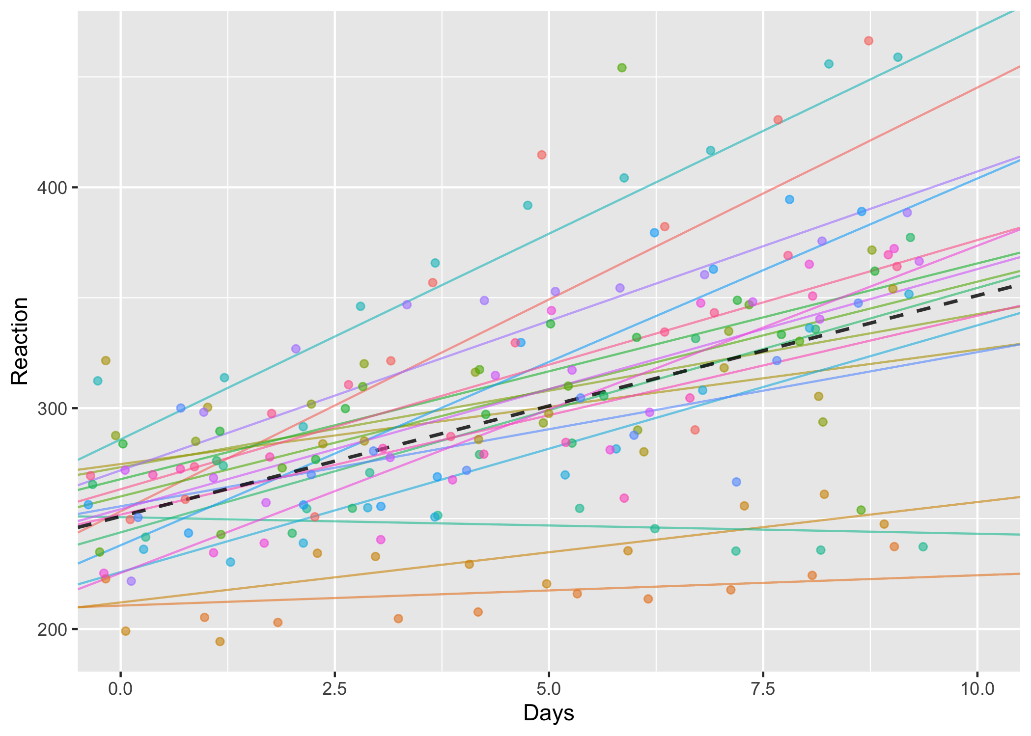

Slide 25
Questions
Is there substantial variation in the effect of sleep deprivation?
Is there substantial variation between subjects in reaction times on average?

Slide 26
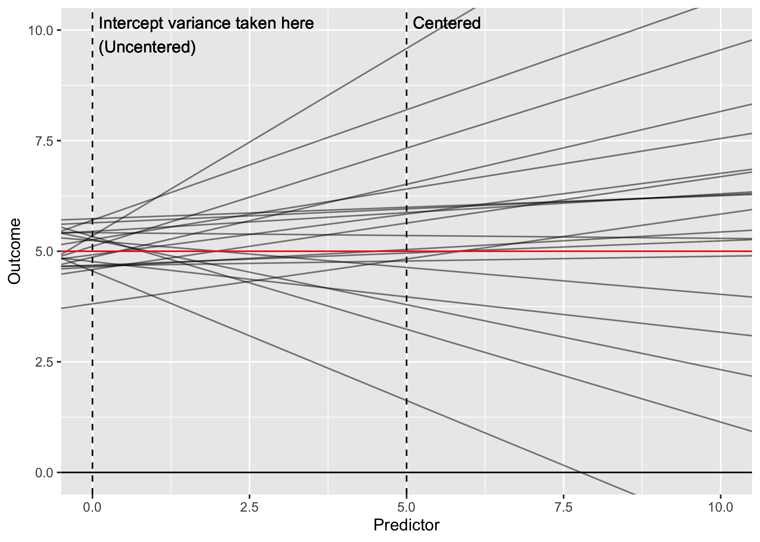

Slide 27
Why is this?
Model parameters are estimated so that you can read them as “the effect of X, when everything else is set to zero”
Same as for multiple regression (e.g. when including a continuous covariate)
Need to be careful because zero may not be a realistic value

Slide 28
Reaction ~ Days + (Days | Subject)

Slide 29
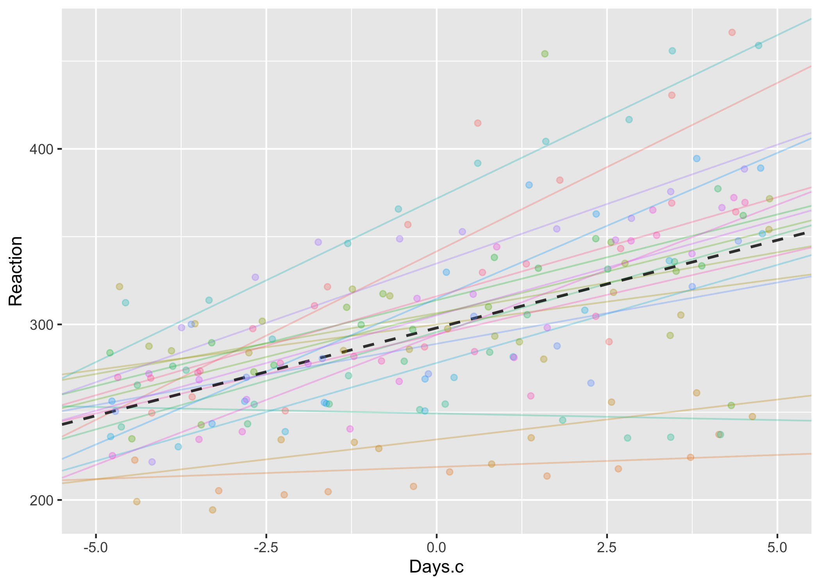
Reaction ~ Days.c + (Days.c | Subject)
sleepstudy %>%
mutate(Days.c = Days - mean(Days))

Slide 30
What to do?
Centering covariates (subtracting the mean) helps because it
Changes the interpretation of other paramaters…
Read as: “The effect of X2, at the average value of X1”
Why? Because we shifted zero so that zero = the average value

Slide 31
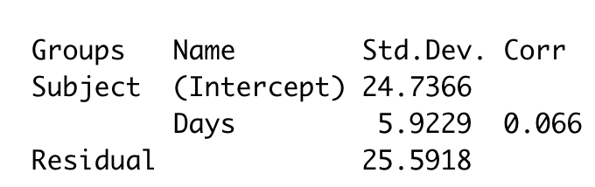
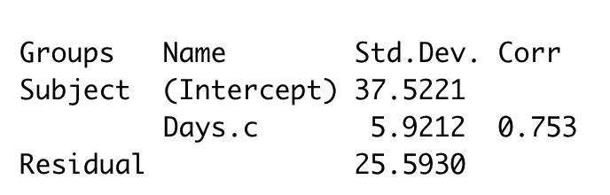


Uncentered/centered variances
Uncentered
Centered

Slide 32
Should everything be centered
Yes!
Probably safer (especially with interactions)
Usually easier to interpret
No!
Sometimes the covariate is on a meaningful scale
Might want to estimate between-variance when X=0 (e.g. at the start of the study)

Slide 33
How to center
cars.c <- mtcars %>%
mutate(wt.c = wt - mean(wt))
cars.c <- mtcars %>%
mutate_if(
is.numeric,
funs( scale(., scale=F) )
)

Slide 34
Two sources of variation
8 male/female speakers,
Say 7 phrases (scenario)
Phrase can be either polite or informal (attitude).
Pitch (frequency) of utterances is measured.
Idemaru, K., Winter, B., & Brown, L. (2015). The role of pitch in perceiving politeness in Korean. In International Conference of Phonetic Sciences, Glasgow.
http://www.bodowinter.com/tutorial/bw_LME_tutorial2.pdf

Slide 38
lmer(frequency ~ attitude + (1|subject) …

Slide 39
lmer(frequency ~ attitude +
(1|subject) +
(1|scenario) …

Slide 40
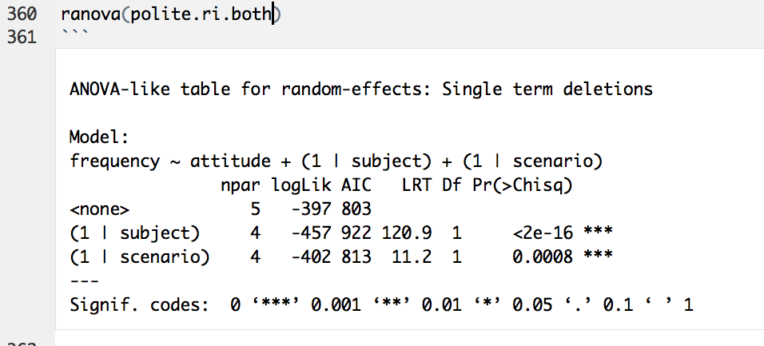

Slide 41
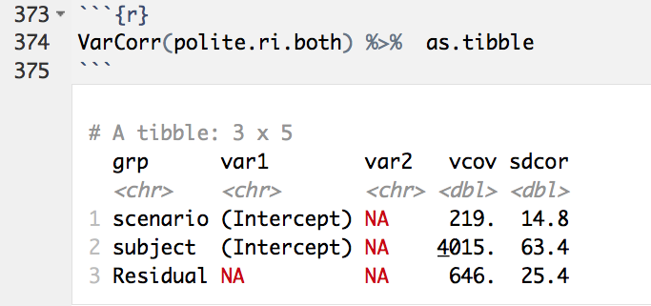
Notes:
Barr, D. J., Levy, R., Scheepers, C., & Tily, H. J. (2013). Random effects structure for confirmatory hypothesis testing: Keep it maximal. Journal of Memory and Language, 68(3), 255–278.

Slide 42
lmer(frequency ~ attitude +
(??|subject) +
(??|scenario) …

Slide 43
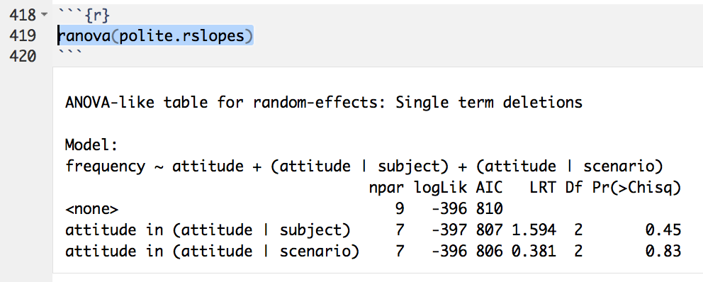
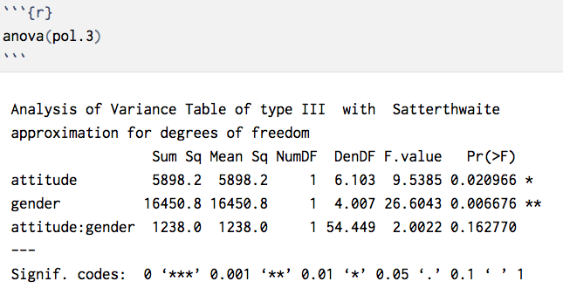
'Keep it maximal' (Barr 2013) (Maximal = More conservative)

Slide 44
If you can’t…
Exclude random effects parameter
lmer assumes correlated random effects by default…

Slide 45
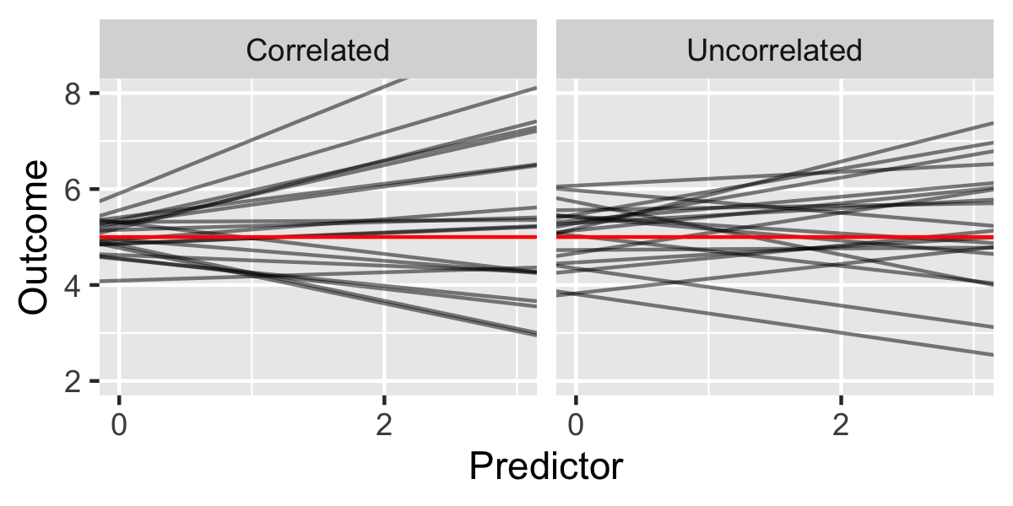

Slide 46
Correlated random effects
These often first to to be dropped when simplifying
Explicitly specifying the random intercept with (1|grouping)
Adding another term which is (0 + variable | grouping)
Reaction ~ Days + (1|Subject) + (0+Days|Subject)

Slide 47
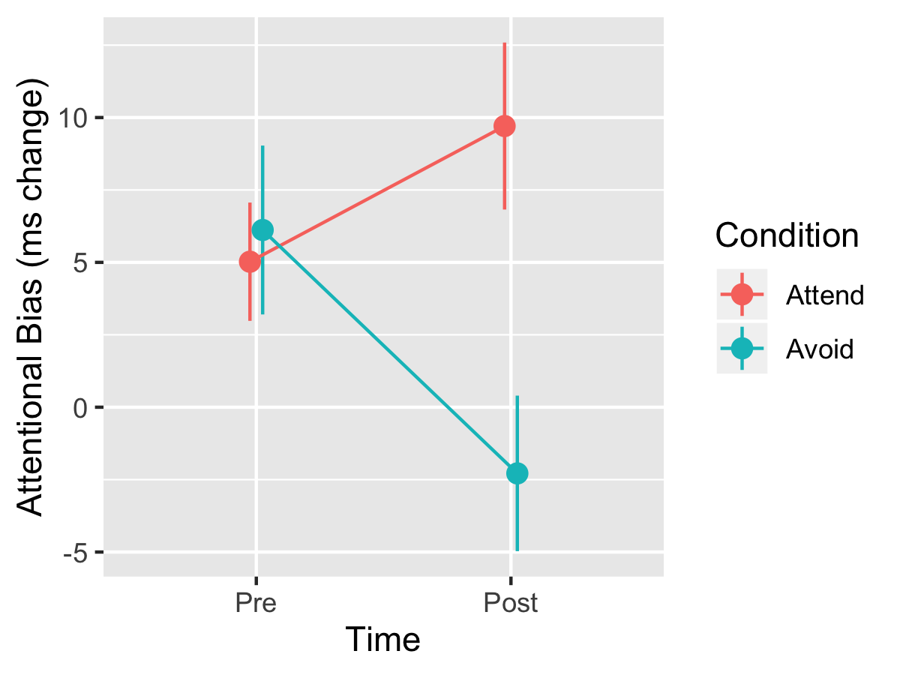
Tests and comparisons Attentional bias (dot probe) experiment
Notes:
https://journals.plos.org/plosone/article?id=10.1371/journal.pone.0226387#sec010
In the training phase, participants completed a modified dot probe task. Only the 16 critical (energy drink–soft drink) picture pairs were used. These were each presented 16 times, for a total of 256 trials, with each picture appearing 8 times on each side of the screen. To combat potential boredom or fatigue, participants were given a brief break halfway through the training. Attentional bias was manipulated by varying the location of the dot probes. In the attend condition, dot probes replaced energy drink pictures on 90% of trials and soft drink pictures on 10% of trials, designed to direct attention toward energy drink cues. Conversely, in the avoid condition, dot probes replaced energy drink pictures on 10% of trials and soft drink pictures on 90% of trials, designed to direct attention away from energy drink cues. A 90–10 distribution was used, as opposed to a 100–0 one, to reduce the obviousness of the contingency [29].

Slide 48
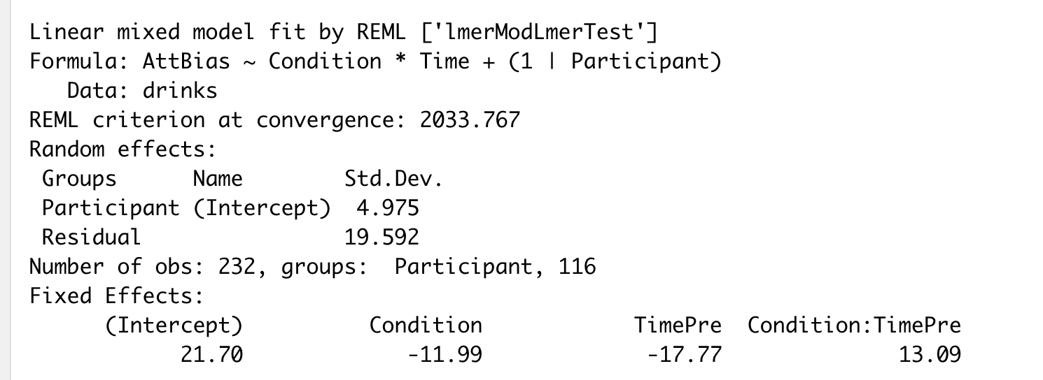
What kind of model is this?

Slide 49
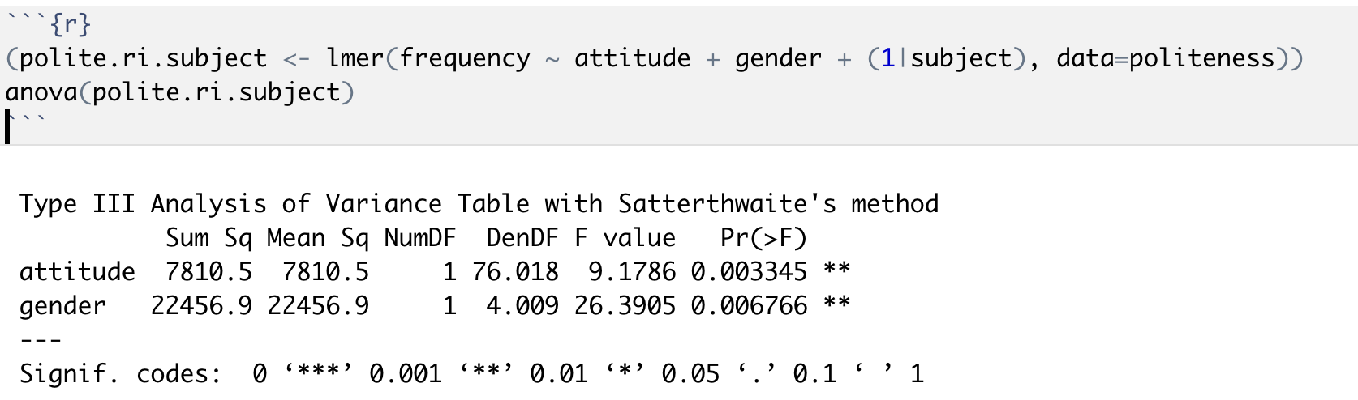
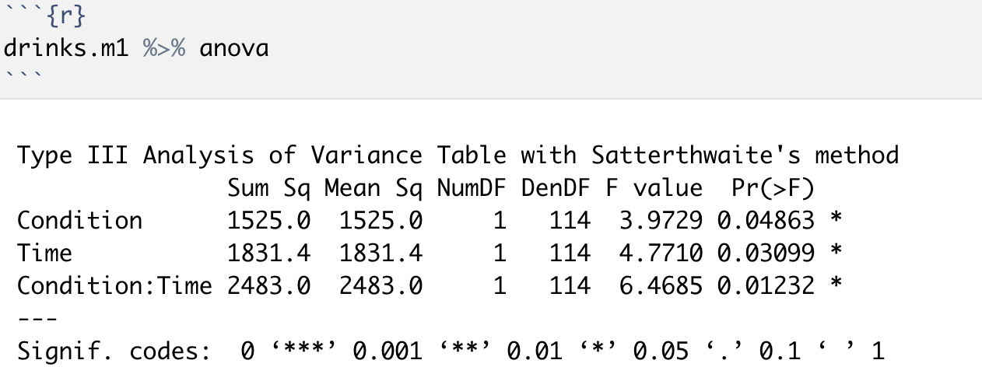

Anova degrees of freedom
Degrees of freedom are adjusted (Satterthwaite method) for the amount of clustering. You will sometimes see non-integer df values.

Slide 50
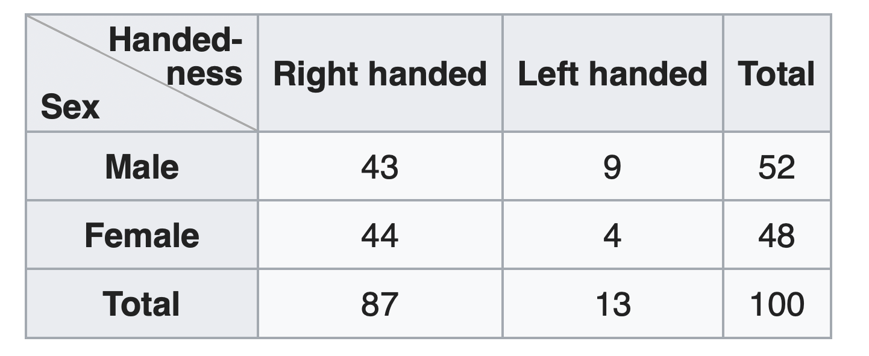
emmeans for followup tests emmeans = estimated marginal means marginal = “averaging across other factors”

Slide 51
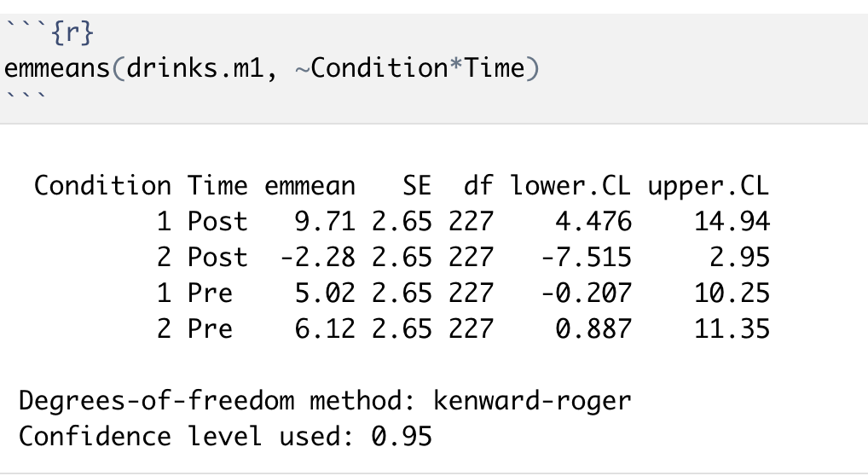
emmeans for followup tests emmeans = estimated marginal means marginal = “averaging across other factors”

Slide 52
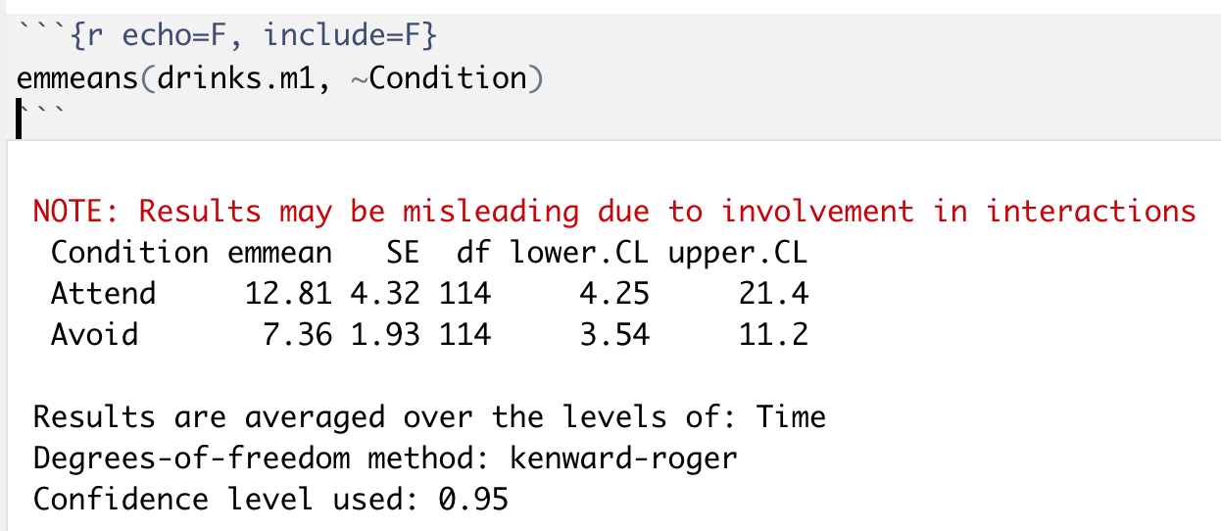
emmeans uses ‘right hand’ formulae

Slide 53
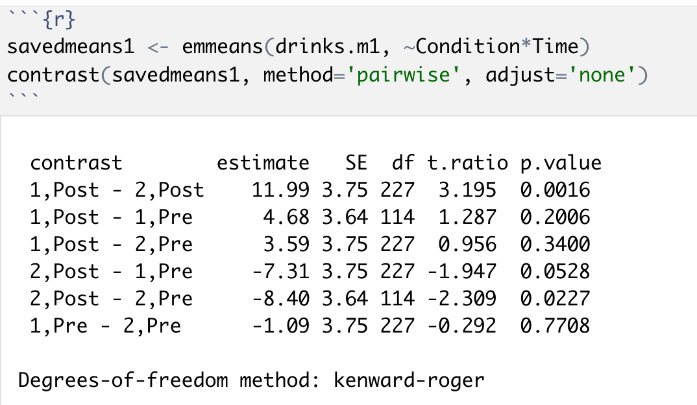
Pairwise contrasts

Slide 54
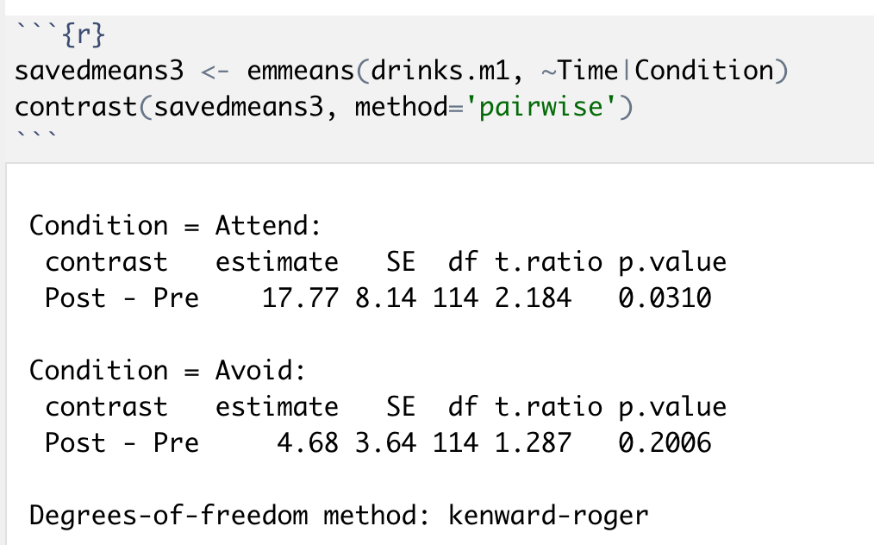

Specific contrasts
Means Time within Condition

Slide 55
problems encountered with convergence for more complex mixed-effects models can be avoided through using Bayesian model fitting given the specification of prior information (Eager & Roy, 2017). Essentially, this is because the incorporation of prior information directs model fitting processes away from extreme values (e.g. random effects variances close to zero) that can cause problems for convergence

